Slide 1
Bio-ASP Server Manual
Reporter: 李尤進 You-Jin Li

Slide 2
Outline
Rules of use
Introduce the GPU Server
First contact
Miniconda
File transfer
Common command
Recommend Software

Slide 3
Rules
Every public user is provided with the following specifications:
1. CPU usage limitation: up to 300% Please add the following code when you execute your program, copy the text in the box, and change the PID number 「cpulimit –pid number --limit 300 」 It means to limit the excuted PID with maximum 300% usage of CPU . Program execution without the limitation will be terminated directly. Users who execution without the limitation code twice in a row, your reservation right will be suspended for one week.
2. RAM usage limited to 30G
3. Hard disk limited to 100G
4. For GPU usage, please fill out the reservation form, including your name and the date you'd like to book. 5. We provide each user with one GPU at a time. Each book in scheduled is 8 hours, and it is assigned according to the sequence of reservation.
6. For any special requirements or emergency circumstances, please contact the server manager.
7. We will create server groups on LINE that can manage and communicate easily

Slide 4
Rules
Public server usage rules:
1. It is forbidden to use jupyter to execute the program. You can use jupyter to edit, but please use the terminal to execute.
2. The system will check the usage once a day to clear idle programs.
3. Please regularly back up private files in case for server failures.
4. The server is plan to restart once every month. The restarting date will be announced previously.
5. The software that users install, use, download, or distribute should not violate intellectual property rights. Users are responsible for all legal disputes and charges derived from illegal usage.
6. Do not distribute viruses or other programs that may damage the system.
7. Do not attempt to hack into unauthorized systems, folders, or files.
8. Do not peep into other user’s files.
9. Users should only use their own accounts and will not share their accounts with others.
10. The use of provided data and information should not be used for non-work purpose without authorization, nor should the users provide the information to non-work related personnel.
11. Please check the private environment once a month to remove unnecessary files.
12. Any user that violates the above regulations, the server manager will ask the user to stop and correct their actions or terminate their user’s rights.

Slide 5

Introduce the GPU Server

Slide 6
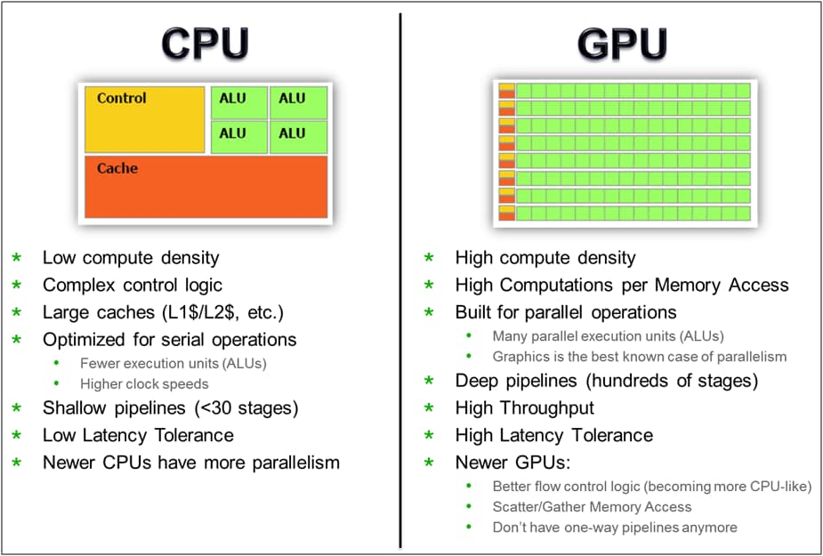
Introduce the GPU Server

Slide 7
Prepare
Computer have support ssh
Windows 10 - CMD
MacOS - terminal
Linux - terminal
IOS - termius
Account and Password
Apply with Yuet and You-Jin
Familiar with the rules

Slide 8
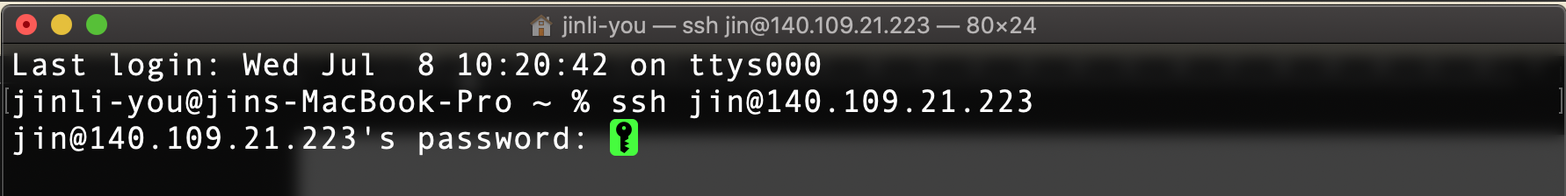
First contact
Server for intern 2020
IP : 140.109.21.223
Open the CMD or terminal
Contact Code is
ssh xxx@140.109.21.223

Slide 9
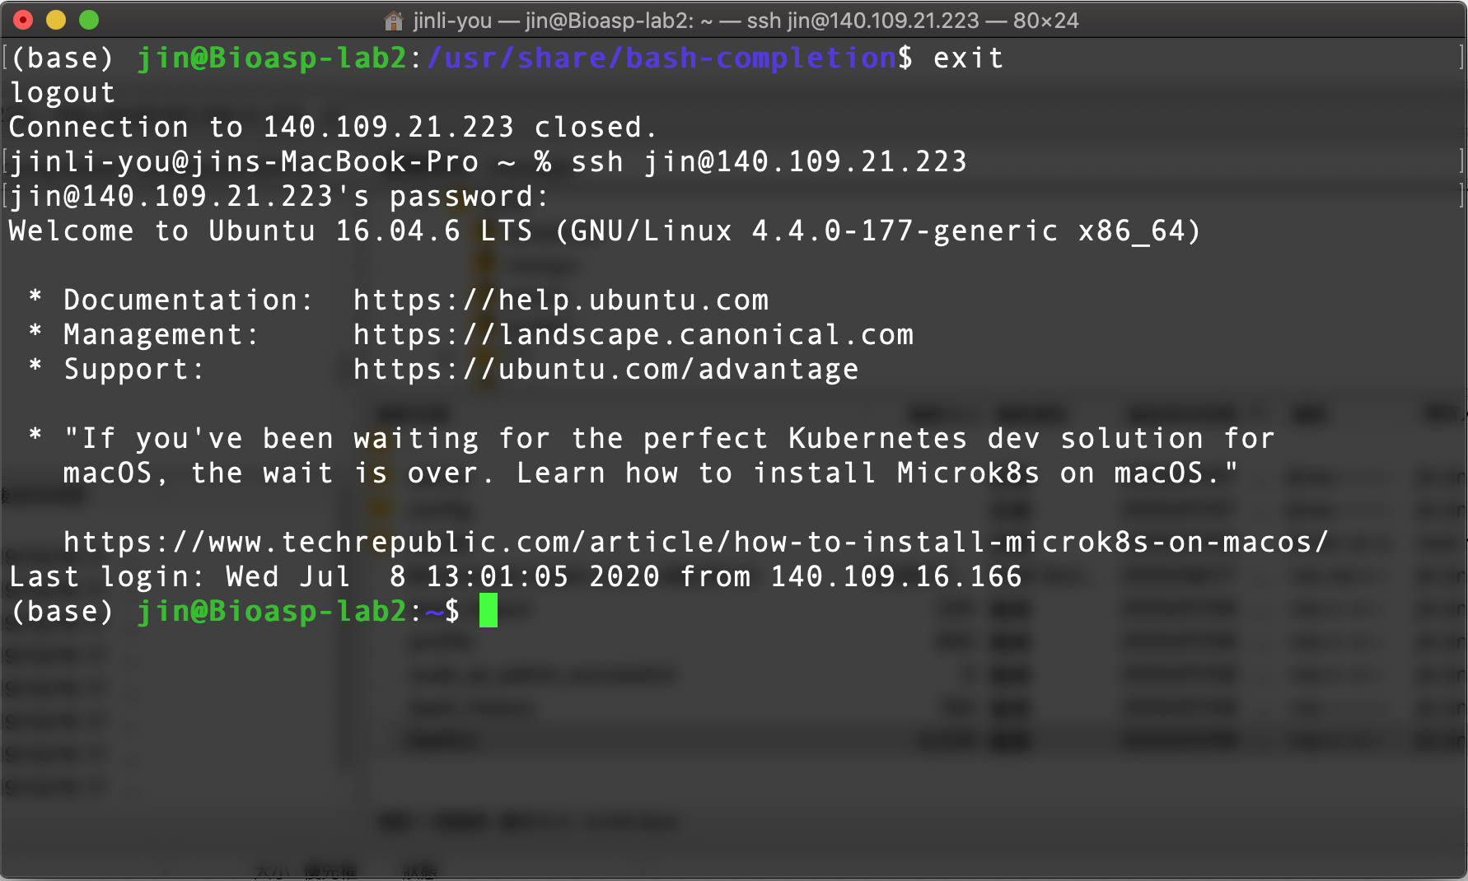
First contact

Slide 10
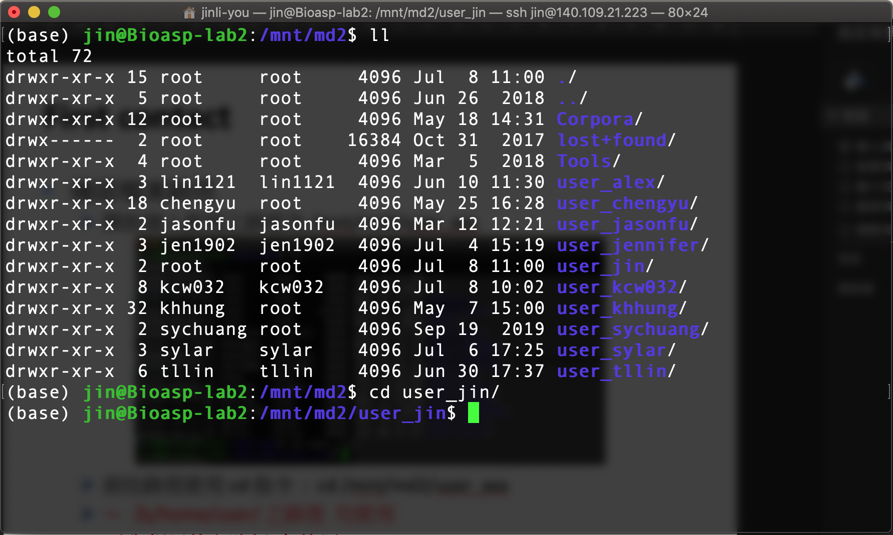
First contact
確認檔案路徑
開放個人使用之路徑為 /mnt/md2/user_xxx
前往路徑使用 cd 指令 : cd /mnt/md2/user_xxx
～ 為/home/user/ 之路徑 勿使用
／ 為根目錄之路徑 勿使用

Slide 11
Miniconda
We used miniconda to manger the environment
Create the environment
Conda create –n {name} python=3.6
Activate the conda environment
Conda activate {name}
Deactivate the conda environment
Conda deactivate

Slide 12
Miniconda
Remove the environment
conda env remove --name myenv
Conda info –env
Common command
Conda list
Pip install tensorflow==2.2

Slide 13
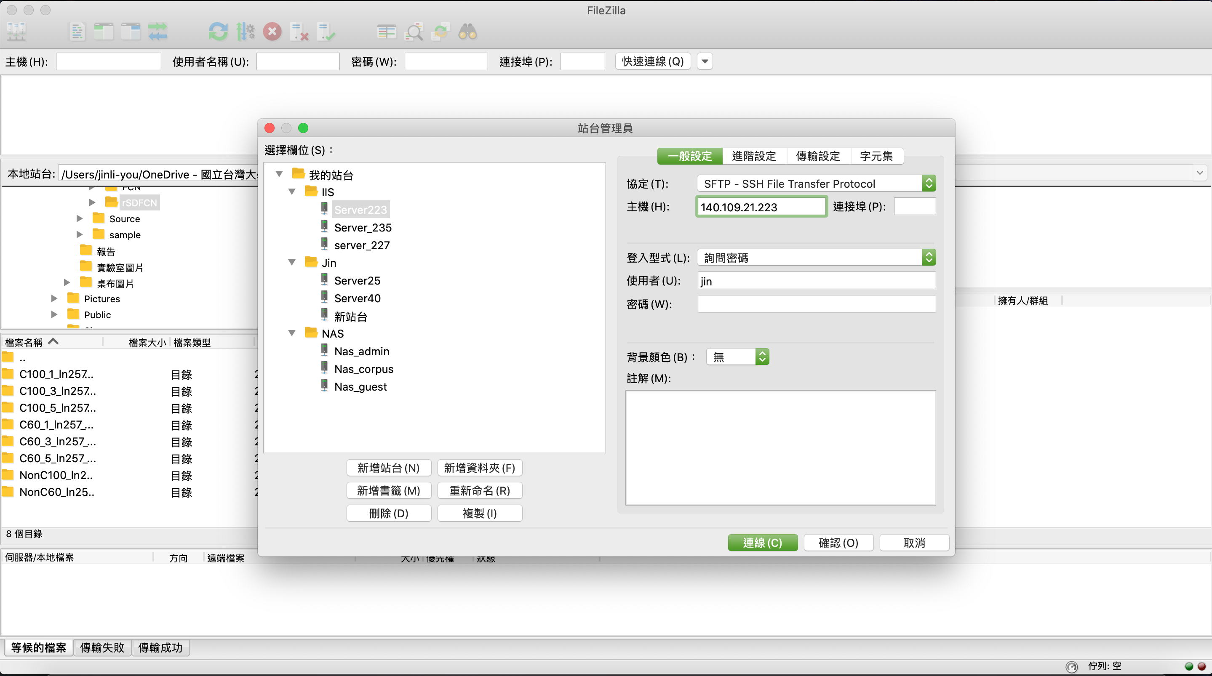
File Transfer
下載測試檔案 Code
傳送檔案使用 Filezilla

Slide 14
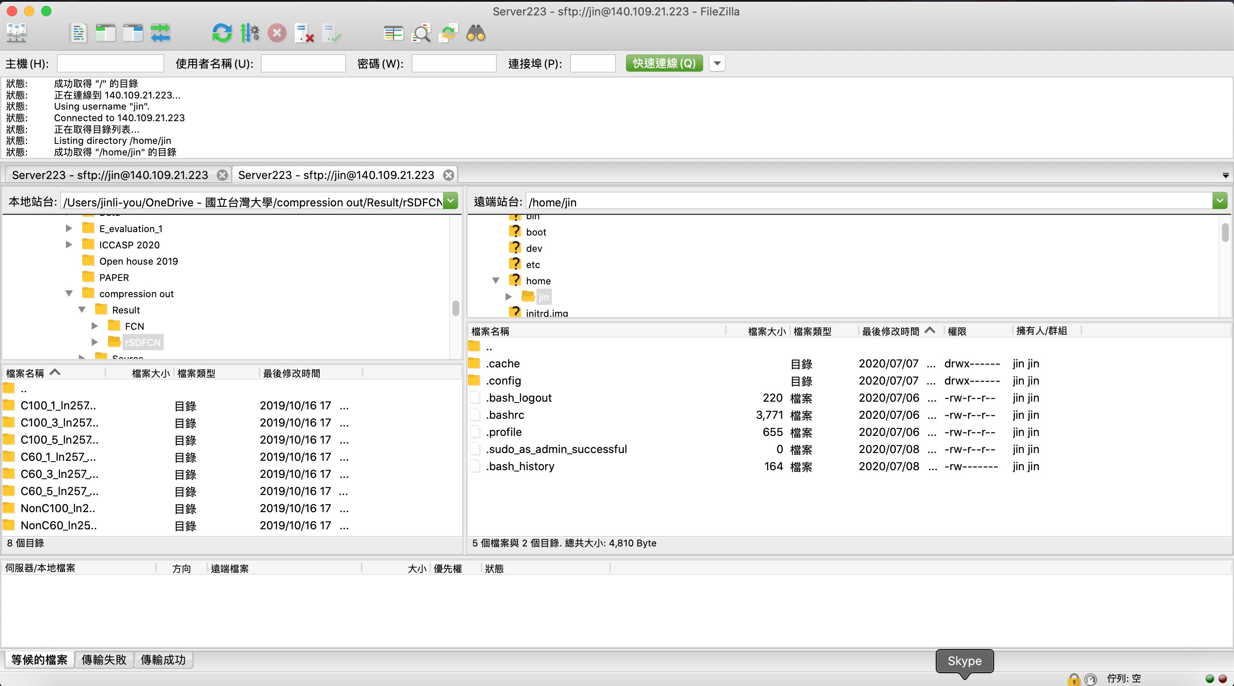
File Transfer

Slide 15
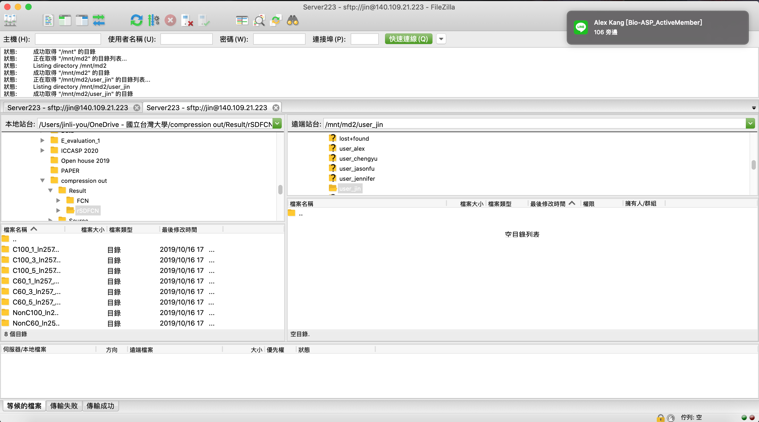
File Transfer
前往個人使用之路徑為 /mnt/md2/user_xxx

Slide 16
File Transfer
前往個人使用之路徑為 /mnt/md2/user_xxx

Slide 17
First Run
screen操作簡易教學：
screen //第一次執行screen
Ctrl a+d //關閉screen(至背景)，也就是detached
screen -rd //重新回到(resume)剛剛的screen 裡
exit //關閉視窗(若只剩一個視窗則為關閉screen)
在進入screen的世界後，都是以熱鍵來做操控，他的原生熱鍵都是以Ctrl+a開始的，(以C-a 代表，C-a c 代表按住 Ctrl 鍵不放再按 a 鍵，然後放開按 c 鍵)最基本必會的幾個熱鍵是:
C-a c 或 C-a C-c #開啟新的視窗，並同時切換到這個新的視窗
C-a n 或 C-a C-n 或 C-a (space) #切換到下一個視窗(0->1 1->2 ...)
C-a p 或 C-a C-p #切換到上一個視窗(1->0 2->1 ...)
C-a C #清除目前的視窗內容
C-a d 或 C-a C-d #脫離（detach）目前的 screen ，並放到背景執行
C-a ? 或 C-a C-? #熱鍵查詢
下載 .screenrc 到～
Source .screenrc
https://mropengate.blogspot.com/2015/09/linux-screen.html

Slide 18
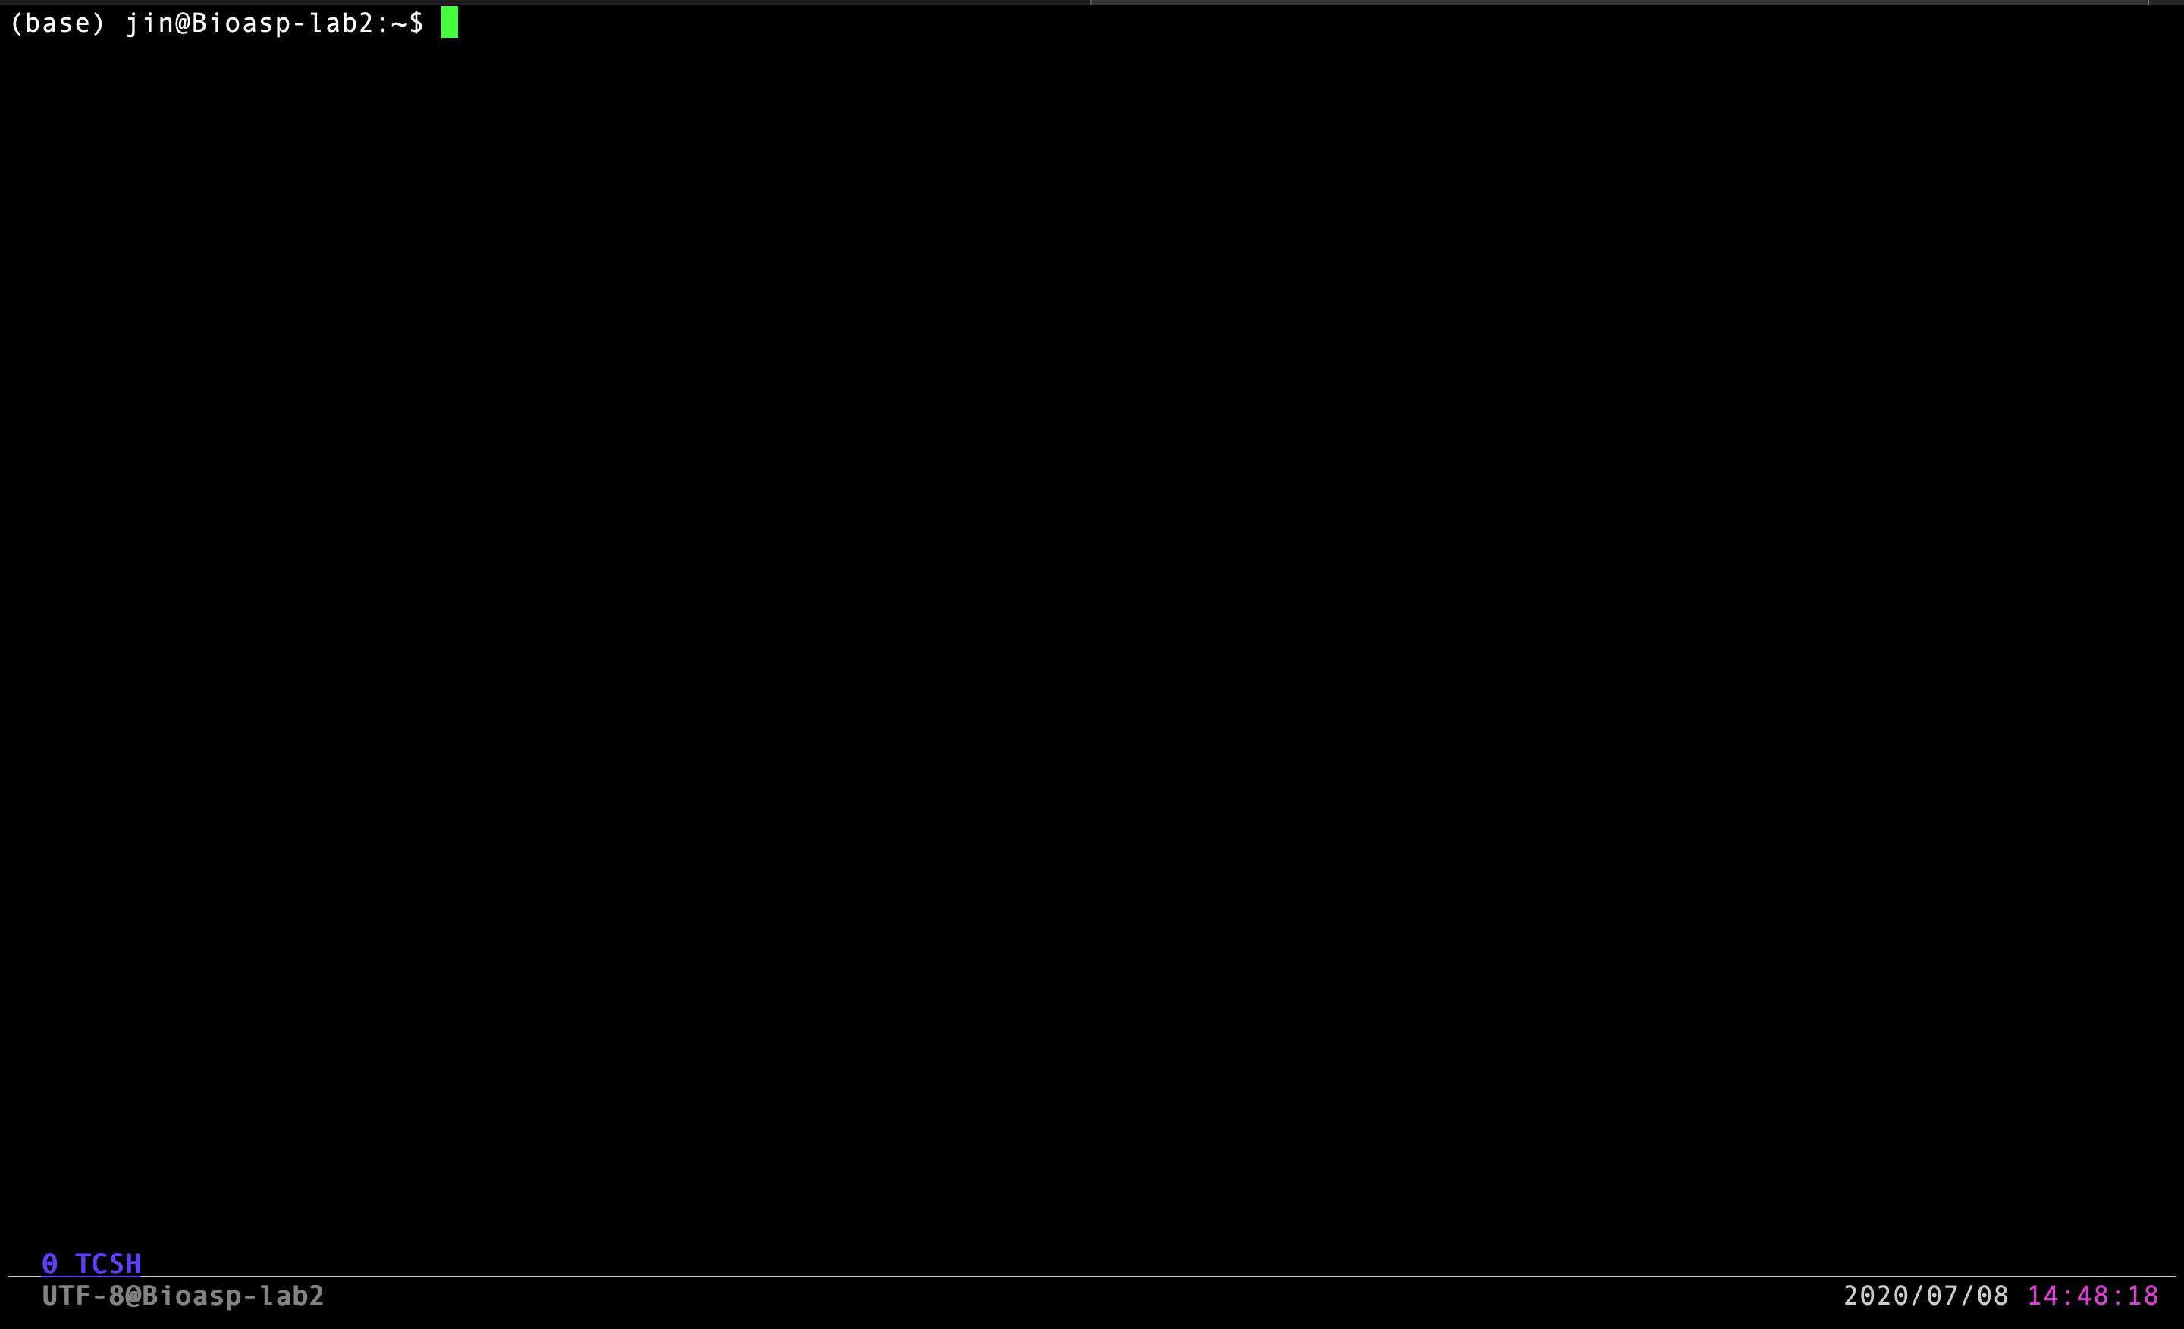
First Run

Slide 19
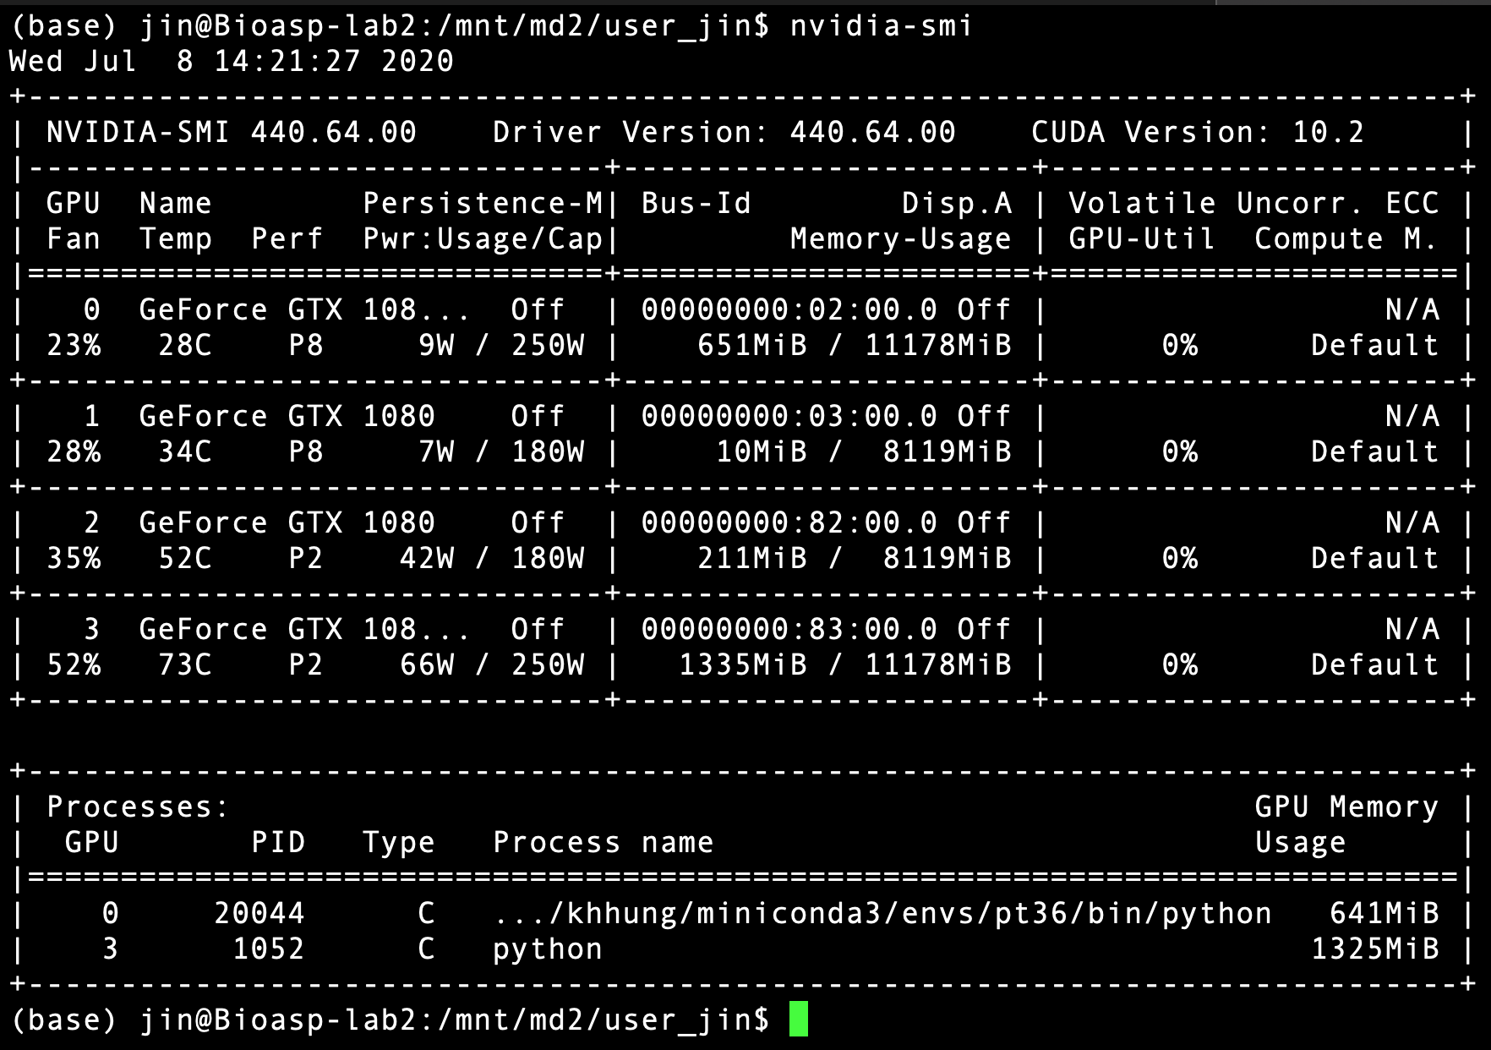
First Run
conda activate /home/chengyu/miniconda3/envs/k11
Check GPU : nvidia-smi

Slide 20
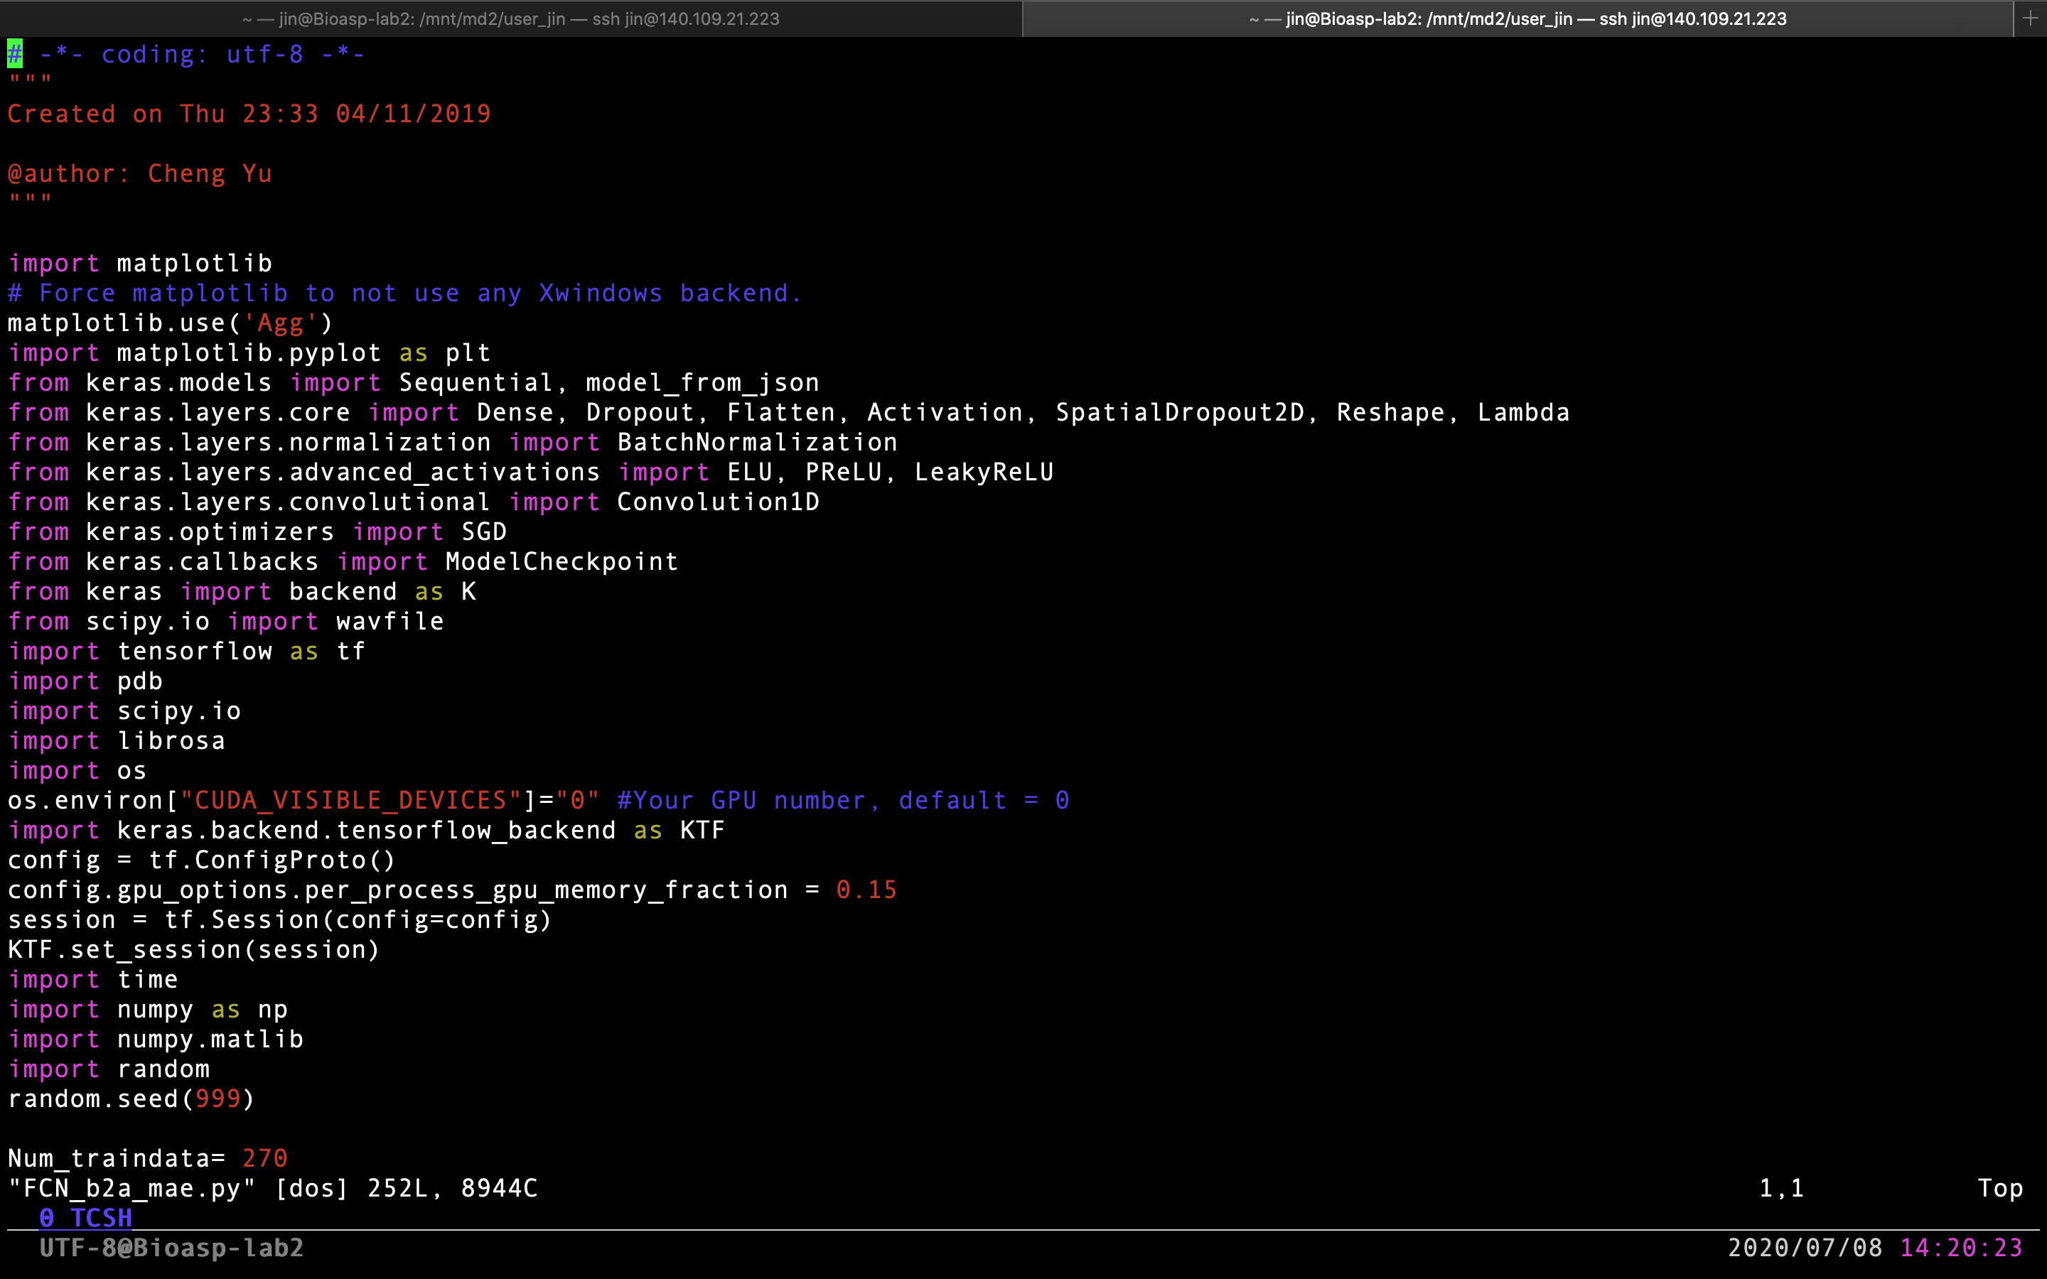
First Run
Vim FCN_b2a_mae.py
離開 :q or :q!
寫入並離開 :wq or :wq!

Slide 21
First Run
Vim FCN_b2a_mae.py
離開 :q or :q!
寫入並離開 :wq or :wq!

Slide 22
First Run
執行之前注意事項
ＧＰＵ該使用第幾張
Free –h 確認 暫存空間
確認目前路徑
執行 python FCN_b2a_mae.py
執行後可以確認執行狀態
Nvidia-smi
htop
離開 :q or :q!
寫入並離開 :wq or :wq!

Slide 23
Common Command
轉移路徑 cd
上一層 cd ..
查看路徑下資料 ls
路徑下資料詳情 ll
創建資料夾
mkdir xxxx
刪除資料夾
rm –R
複製
Cp -r /目標物路徑 /貼上路徑
查看系統資源
Top
Htop

Slide 24
Recommend Software
Windows
Cmd
VSCode
Mobaxterm
Filezilla
WinSCP
Audacity
MacOS and Linux
Terminal
VSCode
Filezilla
Audacity

